Slide 1

Respect my Authority!
A Power BI Admin’s Roadmap
for adoption success
Notes:
One click to add red stripes

Slide 2
Respect my Authority!
A Power BI Admin’s Roadmap
for adoption success
Notes:
One click to remove picture and show scales spinning

Slide 3
Lets work together
A Power BI Admin’s Roadmap
for adoption success
Notes:
Balancing governance and collaboration
Working together with a few counterparts within the org, super users and everyone else who is involved in a centre of excellence (COE)
So far, a lot of buzz-words – like best practices, governance, COE and super users. If you play bullshit bingo, you will probably call bingo now!
As administrators, it's important we empathize with users rather than judge.
Our policies may seem restrictive at times, but they aim to equip the business, not hinder it.
By reaching out first to understand needs, we can tailor governance to balance control with empowerment.
With transparency and open communication, we can build trust and collaborate to securely unlock analytics potential.

Slide 4


SLIDES
Notes:
Power BI administration can feel overwhelming at first.
CLICK FOR IMAGE
But don't worry! Just take it step-by-step.
Focus on learning one thing at a time.
Use the great resources available.
Ask the community for help when you need it.
Be patient with yourself as you build new skills.
Even experienced admins started as beginners.
CLICK FOR QR
Housekeeping - Links are on the images and slides will be on github

Slide 5
Key admin activities in the first two weeks:
Manage user access and security
Configure tenant settings
Manage workspaces and workspace roles
Monitor usage and capacity
Manage gateways to keep data fresh
Establish governance standards and policies
Promote collaboration through apps
Report on adoption and usage
The key is laying the foundation for governed self-service analytics by first focusing on guardrails and controls before enabling end user capabilities.
This builds trust and prevents analytics sprawl.
Notes:
Mention 4 weeks

Slide 6

Week

Slide 7
Get access
Set up security
Configure tenant settings
Assign licenses
Login to http://admin.microsoft.com with an Office 365 administrator account.
Find the user in the list of active users and select it from the list.
Then click on Manage Roles.
Under Admin centre access, expand “Show all by category”, and then from the list, select “Fabric Administrator.”
Notes:
Make friends with your AD administrator – you are about to ask THEM for a lot (and maybe it’s you)
If your business manages roles through PIM (and even if you don’t) your admin may prefer to create an AD group for Power BI Admins and just assign the “Fabric Admin” role there

Slide 8
Get access
Set up security
Configure tenant settings
Assign licenses
Start by creating some more specialised groups to control the backstage activities:
PowerBI-GatewayAdmin
Install and configure on-premises data gateways to enable access to
on-prem data sources.
PowerBI-WorkspaceCreator
Allowing any user to create workspaces can lead to proliferation
of uncontrolled workspaces.
PowerBI-DemoViewer
Dynamic membership (user.objectId -ne null) and (user.userType -eq "member")
PowerBI-API
Used to add the managed identity of a data factory so that we can extract tenant metadata on an automated basis.
Notes:
Install and configure on-premises data gateways to enable access to on-prem data sources.
Keep them UP TO DATE
Determine optimal gateway placement on allowed networks with required drivers and dependencies installed.
Manage gateway connections, encryption keys, and credentials securely.
It is advisable to follow the principle-of-least-privilege and give only the permissions necessary for completing dedicated functions, a very high-level decision to make early on is who really needs to be able to create/delete workspaces, your answer really informs the kind of setup you are going to have.
I put these two topics together because I think they need to be considered at the same time.
At a minimum I always create these AD groups:
Group Name Group Type
PowerBI-Users Microsoft 365
PowerBI-Admins Security
PowerBI-GatewayAdmin Security
PowerBI-WorkspaceCreator Security
PowerBI-APIs Security
The "PowerBI-Users" group is of the Microsoft 365 type because you can then have a Teams team where all Power BI users can share hint/tips/problems and this group can also be set to grant a Power BI Pro license as well, making it a great central point of maintenance.

Slide 9
Get access
Set up security
Configure tenant settings
Assign licenses
Start by creating some more specialised groups to control the backstage activities:
PowerBI-GatewayAdmin
Install and configure on-premises data gateways to enable access to
on-prem data sources.
PowerBI-WorkspaceCreator
Allowing any user to create workspaces can lead to proliferation
of uncontrolled workspaces.
PowerBI-DemoViewer
Dynamic membership (user.objectId -ne null) and (user.userType -eq "member")
PowerBI-API
Used to add the managed identity of a data factory so that we can extract tenant metadata on an automated basis.
Notes:
Implement a workspace request process for other users to submit business justification.
Expand workspace creation access more broadly over time in a governed manner.
Educate users that workspaces are for collaboration, not personal storage.

Slide 10
Get access
Set up security
Configure tenant settings
Assign licenses
Start by creating some more specialised groups to control the backstage activities:
PowerBI-GatewayAdmin
Install and configure on-premises data gateways to enable access to
on-prem data sources.
PowerBI-WorkspaceCreator
Allowing any user to create workspaces can lead to proliferation
of uncontrolled workspaces.
PowerBI-DemoViewer
Dynamic membership (user.objectId -ne null) and (user.userType -eq "member")
PowerBI-API
Used to add the managed identity of a data factory so that we can extract tenant metadata on an automated basis.
Notes:
All users – Member only (no guests)

Slide 11
Get access
Set up security
Configure tenant settings
Assign licenses
Start by creating some more specialised groups to control the backstage activities:
PowerBI-GatewayAdmin
Install and configure on-premises data gateways to enable access to
on-prem data sources.
PowerBI-WorkspaceCreator
Allowing any user to create workspaces can lead to proliferation
of uncontrolled workspaces.
PowerBI-DemoViewer
Dynamic membership (user.objectId -ne null) and (user.userType -eq "member")
PowerBI-API
Used to add the managed identity of a data factory so that we can extract tenant metadata on an automated basis.
Notes:
All users – Member only (no guests)

Slide 12
Get access
Set up security
Configure tenant settings
Assign licenses
Now let’s discuss 4 broad groups for your Power BI users:
Admin
Contributor
Tester
Viewer
Try to use the principle of least privilege.
Notes:
The key is assigning minimal required permissions to give users self-service access while maintaining control.
Naming conventions and Domains
One of the most common uses for domains is to group data by business department, making it possible for departments to manage their data according to their specific regulations, restrictions, and needs.
https://community.fabric.microsoft.com/t5/Community-Blog/Domain-Preview-Power-BI-Services/ba-p/3308166

Slide 13
Get access
Set up security
Configure tenant settings
Assign licenses
Start with 4 broad groups for your Power BI users:
PowerBI-{Domain}-Admin
PowerBI-{Domain}-Contributor
PowerBI-{Domain}-Tester
PowerBI-{Domain}-Viewer
Try to use the principle of least privilege.
Notes:
AD Groups should follow security best practices and be maintained as new employees join/leave the organization;
I recommend hooking the viewer groups into existing distribution lists or using dynamic membership
https://datameerkat.com/domains

Slide 14
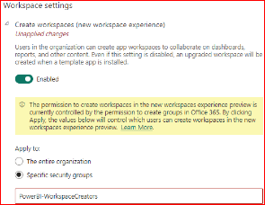
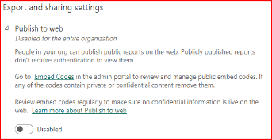
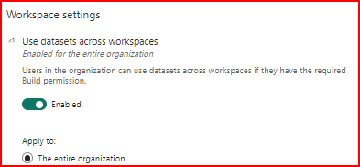
Get access
Set up security
Configure tenant settings
Assign licenses
Workspace Creator
Publish to web
Dataset sharing
Notes:
If you miss configuring the settings properly, it may result in leaking the data, authorizing people who should not be authorized to see reports and many other catastrophic scenarios
Remember those groups we just created; this is where we will use them.
You may want to restrict pro trials at this time too
https://radacad.com/power-bi-administrator-tenant-settings-configuration-you-dont-dare-to-miss
Create workspaces - restrict to PowerBI-WorkspaceCreators
Publish to web - Disabled for the entire organisation Use datasets across workspaces - Enabled for the entire organisation Add and use certified visuals only (block uncertified) – enabled Allow service principals to use Power BI APIs - Enabled for "PowerBI-APIs“ Allow service principals to use read-only admin APIs - Enabled for "PowerBI-APIs" Enhance admin APIs responses with detailed metadata - Enabled for "PowerBI-APIs" Enhance admin APIs responses with DAX and mashup expressions - Enabled for "PowerBI-APIs“
I usually also tweak the following settings from a security / governance stand-point:
Allow Azure Active Directory guest users to access Power BI - restrict to specific security group
Invite external users to your organization - restrict to specific security group
Allow Azure Active Directory guest users to edit and manage content in the organization - restrict to specific security group
Publish to web - Disabled. Enable only if the need comes up - which in my experience is extremely rare.
Allow specific users to turn on external data sharing - restrict to specific security group
The key word here is EXTERNAL - it's features geared towards sharing Power BI artefacts outside your organization -> handle with care.

Slide 15
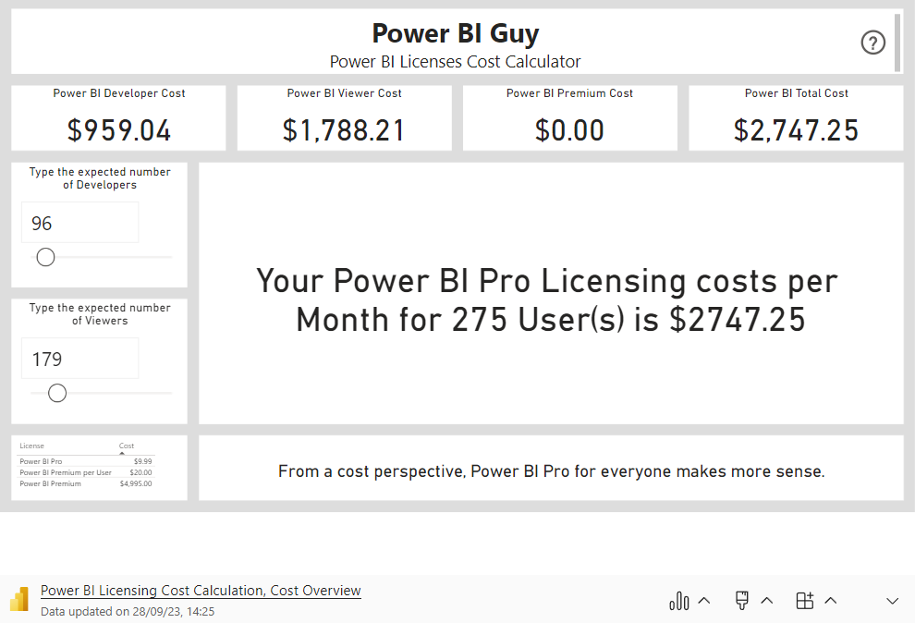
Get access
Set up security
Configure tenant settings
Assign licenses
Notes:
Purchase and assign Power BI licenses to users
Decide on Pro vs Premium vs Fabric
E5 gets Pro for free – advise to turn that off to encourage community practices
https://app.powerbi.com/view?r=eyJrIjoiOTc4Y2Q2YzAtOTAwZi00OWJiLWE4MDctN2MyOGU2M2Q5NWNjIiwidCI6IjIxMmFhOGVkLTcxYzYtNGY3ZS1hM2Q1LWNjOWQ2NmZiZGY5YSJ9&pageName=ReportSection

Slide 16

Week

Slide 17
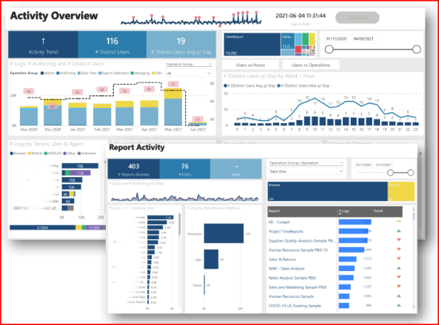
Create workspaces
Build admin reports
Install Gateways
Build a workspace for usage monitoring
Notes:
https://github.com/RuiRomano/pbimonitor
https://www.youtube.com/watch?v=viMLGEbTtog

Slide 18
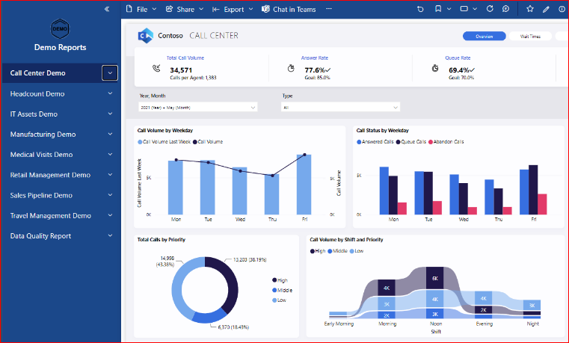
Create workspaces
Build admin reports
Install Gateways
Build a workspace for demo reports
Notes:
One of the most powerful things that I usually do when building a Power BI community from scratch is to deploy a group of demo reports that work together to show end-users the power of developing a consistent theme and to show the art of the possible as it can help people get an idea in their head about what can be done with this newfangled tool.
My favourite set of reports to deploy can be found here:
https://github.com/PowerBiDevCamp/pbix-samples/tree/main/Miguel%20Myers%20Demos

Slide 19
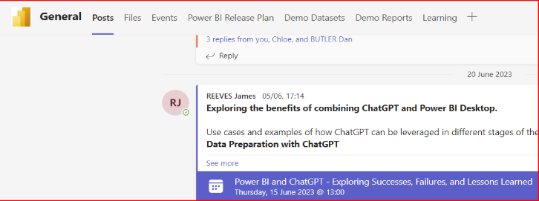
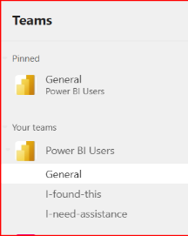
Create workspaces
Build admin reports
Install Gateways
Put it where they can see it
Notes:
Data Hub – make it available in Teams

Slide 20
Create admin workspace
Build admin reports
Install Gateways
Can you answer these questions?
Who are most active users
Which Reports/Workspaces/Datasets/Apps are used every day
How is content being shared & distributed? Any content on My Workspace
Do your users access from Browser/Mobile/Excel? Which browser
Top used Data Source’s
How many distinct users (Per Month, Per day, Per hour)
Datasets/Reports not used recently
How many users with license don’t use Power BI in more than 3 months
Are developers following the naming conventions
Notes:
https://github.com/RuiRomano/sessionslides/blob/main/PBIMonitoring101.pdf

Slide 21
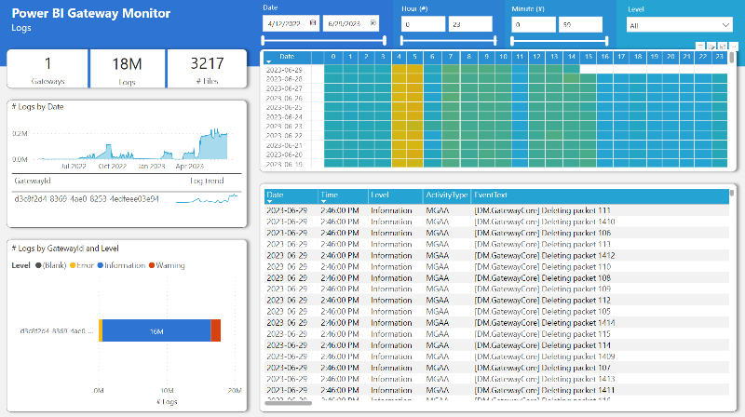
Create admin workspace
Build admin reports
Install Gateways
Install and configure on-premises data gateways
Notes:
https://github.com/RuiRomano/pbigtwmonitor
https://www.youtube.com/watch?v=0Enini93Quk

Slide 22
Week

Slide 23
Monitor usage
Address issues
Promote content
Report to stakeholders Train Users
Review adoption, consumption, most used reports
Notes:
Create your baselines – something to refer back to in future

Slide 24

Monitor usage
Address issues
Promote content
Report to stakeholders
Train Users
Troubleshoot based on user feedback

Slide 25
Monitor usage
Address issues
Promote content
Report to stakeholders
Train Users
Feature examples and best practices from users

Slide 26
Monitor usage
Address issues
Promote content
Report to stakeholders
Train Users
Share Power BI rollout insights and next steps

Slide 27
Monitor usage
Address issues
Promote content
Report to stakeholders
Train Users
Conduct training webinars on new features and self-service

Slide 28

JAMES REEVES
Azure Consultant
Let’s connect!

